Slide 1
Who Am I?

Slide 2
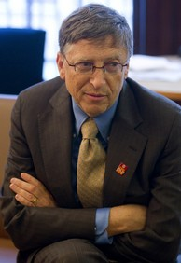
Billionaire: Software
Bill Gates Microsoft

Slide 3
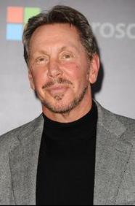
Billionaire: Software
Larry Ellison
Oracle

Slide 4
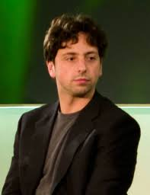
Billionaire: Software
Sergei Brin
Google

Slide 5
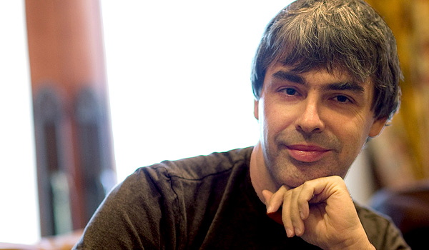
Billionaire: Software
Larry Page
Google

Slide 6
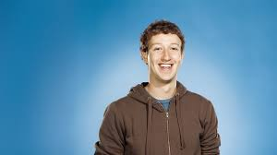
Billionaire: Software
Mark Zuckerberg
Facebook

Slide 7
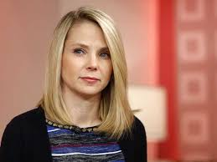
> ¼ Billionaire: Software
Melissa Mayer
Yahoo

Slide 8
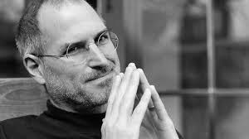
Billionaire: Software
Steve Jobs
Apple

Slide 9
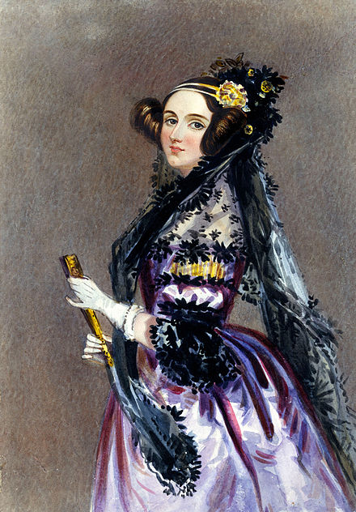
Programming was her idea
Lady Ada August
Countess of Lovelace Mathematician Collaborator with Charles Babbage
The Analytical Engine weaves algebraical patterns just as the Jacquard loom weaves flowers and leaves.

Slide 10
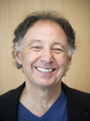
But Has Fun (and so can you)
Not A Billionaire: Software

Slide 11
Dollars and Cents
Software Developer
Projected to grow 17% from 2014 to 2014
“Much faster than the average for all occupations”
Computer Scientist
Projected to grow 11% from 2012 to 2022
“Computer scientists are likely to enjoy excellent job prospects, because many companies report difficulties finding these highly skilled workers.”
(Bureau of Labor Statistics)

Slide 12
What Does This Mean?
Opportunity!!!

Slide 13
Software Developers
Build the next generation of systems and applications software
For social media, communications devices, medicine, film, games, …

Slide 14
Computer Scientists
Discover the possible
In robotics, artificial intelligence, data mining, speech recognition, scientific visualization, sensor networks …

Slide 15
Software Developers and Computer Scientists
Work with engineers scientists from every discipline
Without computation, there is neither science, nor engineering, nor life as we know it

Slide 16
Here’s How to Do It

